Slide 1
Linear regression
Session 3:
Checking the assumptions
Multiple linear regression

Slide 2
Session 3: Simple and multiple linear regression, Checking the assumptions
Testing the assumptions:
Linearity
Homogeneity of variance
Normality
Independence of observations
Exceptional values = outliers
Influential observations
Transformation
Notes:
The term “multiple” in “multiple regression” is explained by the fact that the number of independent variables in the model is larger than 1.
The analysis of variance will help us to determine the “goodness of fit”, the technical term for what might also be called “precision” of the model. It will clarify the role of each variable, and help to decide which variable(s) to put into the model, taking the principle of parsimony into account.
We shall see that a strategy is needed to define the most appropriate order by which terms are introduced into the model.
See further!

Slide 3
Checking the assumptions
Before we do a regression analysis, it is important to consider the assumptions that underlie the method:
The relation between the two variables should be linear -> linearity
The variability of y, as assessed by the variance or standard deviation, should be the same for each value of x -> homogeneity
The values of variable y should have a Normal distribution for each value of variable x -> normality
The observations should be independent
Notes:
When we do a regression analysis it is important to consider the assumptions that underlie the method, these are:
-the relation between the two variables should be linear
-the variability of y, as assessed by the variance or standard deviation, should be the same for each value of x
-the values of y should have a Normal distribution for each value of x
-the observations should be independent

Slide 4
Checking the assumptions
If the assumptions do not hold, the outcome of the regression analysis is not valid / does not make sense!
Some of these conditions can be checked from a scatter diagram, so before the regression analysis.
Other assumptions have to be checked after the regression analysis has been completed. To do this, we analyse the residuals -> makes anomalies more visible (‘magnifying glass’).
Notes:
Some of these conditions, e.g. linearity, homogeneity, can usually be checked in a reasonable way from a scatter diagram, so before the regression analysis. Other assumptions have to be checked after the regression analysis has been completed. To do this, we use the residuals. The analysis of the residuals allows us to check whether anomalies are present. In fact, the role of this analysis is to make these anomalies more visible, like a magnifying glass.

Slide 5
Checking the assumptions
Analysis of residuals to check for:
linearity
homogeneity of variance
normality
independence of observations
Other diagnostic checks: exceptional values, influential observations
Correct certain anomalies by:
Transformation

Slide 6
Notes:
<scatter plot age -> cholest with residuals>
To remind you: the residuals ε_{i} are the distances between the observed values y_{i} and the values y_{i}^ estimated by the regression.

Slide 7
Linearity
Relationship x → y linear? Verify by...
scatter plot: ε depending on
Relationship linear if: random distribution of ε_{i} around the horizontal axis
Notes:
The first question to be answered by the analysis of residuals: is the relationship between x and y linear? If yes, one expects a random distribution of the residuals depending on x, like a cloud.
If the relationship between x and y is non-linear, this non-linearity becomes more visible in the scatter plot x → ε than in the original scatter plot x → y.

Slide 8
Notes:
<Scatter plots x → y and x → ε, linear and non-linear>

Slide 9
Homogeneity of variance
Is the variance of y homogenous? Verify by...
scatter plot: ε depending on
Variance homogenous if: random distribution of ε_{i} around the horizontal axis
Notes:
The second question to be answered by the analysis of the residuals concerns the homogeneity of variance. This question can be answered by a scatter plot y^ → ε.
If the variance of y_{i} is homogenous, the residuals should be distributed at random depending on the estimated dependent variable y^.

Slide 10
Notes:
<Scatter plot x → y and y^ → ε, variance homogenous / heterogeneous>

Slide 11
Normality
Are residuals normally distributed? Verify by…
histogram
Notes:
Third question: residuals should be distributed normally. The normality can be checked directly by inspection of a histogram.
The normal plot offers another way to check the normality of a distribution.

Slide 12
Independence of observations
The observations should be independent, i.e. one observation must not influence another one
Problematic in case of sequential observations (in time or space).
Notes:
Four: are the observations independent? In practice this means that there should be only one observation per individual. In case of sequential observations, an auto-correlation can exist. This means that the result of observation i influences the result of observation j.
An example for observations that are sequential in time: measurements of blood pressure in the same individual, once an hour. Observing one pathological value at the ith hour increases the probability to observe another pathological value in the hour i + 1.
The same problem may exist in case of observations that are sequential in space.
There are several statistics that check for auto-correlation, for example the one of Durbin-Watson.

Slide 13
Exceptional values = outliers
Values of y that are far from the linear regression line. To be recognised by...
scatter plot: ε depending on
Notes:
Other diagnostic checks that we can make by analysis of residuals: outliers and influential observations.
An exceptional value y, also called outlier, is a value that is much larger or smaller than the value y^ estimated by the linear regression. Such a value can easily be recognised by a scatter plot of ε depending on y^.

Slide 14
Notes:
<scatter plot: exceptional value>
NB: Outliers may represent an error - or the most interesting finding of your study! Therefore: very careful consideration must be made before removing them from the data set!

Slide 15
Influential observations
Observation of an x that is far from the other x values. Easily recognised by…
scatter plot: ε depending on
Notes:
Influential observations are those that are far from the majority of observations. They can have a considerable impact on the regression line. To recognise them, a scatter plot of ε depending on x is appropriate.
Statistics can quantify the role of influential observations (e.g. statistic of Cook)

Slide 16
Notes:
<scatter plot influential observation>

Slide 17
Checking the assumptions, fitted values and residuals
age | cholesterol
20 | 1.9
22 | 2.1
28 | 2.3
22 | 2.5
24 | 2.5
30 | 2.6
28 | 2.9
25 | 3
33 | 3
34 | 3.2
40 | 3.2
29 | 3.3
50 | 3.3
46 | 3.5
36 | 3.8
43 | 3.8
58 | 3.9
49 | 4
52 | 4
57 | 4.1
48 | 4.2
52 | 4.3
57 | 4.5
63 | 4.6

Slide 18
Checking the assumptions, fitted values and residuals
age | cholesterol | Fitted*
20 | 1.9 | 2.33
22 | 2.1 | 2.44
28 | 2.3 | 2.75
22 | 2.5 | 2.44
24 | 2.5 | 2.54
30 | 2.6 | 2.86
28 | 2.9 | 2.75
25 | 3 | 2.60
33 | 3 | 3.02
34 | 3.2 | 3.07
40 | 3.2 | 3.38
29 | 3.3 | 2.81
50 | 3.3 | 3.91
46 | 3.5 | 3.70
36 | 3.8 | 3.17
43 | 3.8 | 3.54
58 | 3.9 | 4.33
49 | 4 | 3.86
52 | 4 | 4.02
57 | 4.1 | 4.28
48 | 4.2 | 3.81
52 | 4.3 | 4.02
57 | 4.5 | 4.28
63 | 4.6 | 4.60
*Fill in the equation:
Fitted = 1.28 + 0.053*Age

Slide 19
Checking the assumptions, fitted values and residuals
age | cholesterol | fitted | Residual*
20 | 1.9 | 2.33 | -0.43
22 | 2.1 | 2.44 | -0.34
28 | 2.3 | 2.75 | -0.45
22 | 2.5 | 2.44 | 0.06
24 | 2.5 | 2.54 | -0.04
30 | 2.6 | 2.86 | -0.26
28 | 2.9 | 2.75 | 0.15
25 | 3 | 2.60 | 0.40
33 | 3 | 3.02 | -0.02
34 | 3.2 | 3.07 | 0.13
40 | 3.2 | 3.38 | -0.18
29 | 3.3 | 2.81 | 0.49
50 | 3.3 | 3.91 | -0.61
46 | 3.5 | 3.70 | -0.20
36 | 3.8 | 3.17 | 0.63
43 | 3.8 | 3.54 | 0.26
58 | 3.9 | 4.33 | -0.43
49 | 4 | 3.86 | 0.14
52 | 4 | 4.02 | -0.02
57 | 4.1 | 4.28 | -0.18
48 | 4.2 | 3.81 | 0.39
52 | 4.3 | 4.02 | 0.28
57 | 4.5 | 4.28 | 0.22
63 | 4.6 | 4.60 | 0.00
*Residual= Cholesterol - fitted

Slide 20
Checking the assumptions R
Cholesterol$fitted.LinearModel.2 <- fitted(LinearModel.2)
Cholesterol$residuals.LinearModel.2 <- residuals(LinearModel.2)
age | cholesterol | sex | occupation | bmi | activity | residuals.LinearModel.2 | fitted.LinearModel.2
20 | 1.9 | M | 4 | 16.7 | 24 | -0.43236644 | 2.332366
22 | 2.1 | F | 4.00 | 19.2 | 22 | -0.337616249 | 2.437616
28 | 2.3 | M | 2.00 | 22.1 | 24 | -0.453365675 | 2.753366
22 | 2.5 | M | 1.00 | 20.8 | 26 | 0.062383751 | 2.437616
24 | 2.5 | F | 4.00 | 20.9 | 18 | -0.042866057 | 2.542866
30 | 2.6 | M | 2.00 | 18.7 | 13 | -0.258615484 | 2.858615

Slide 21
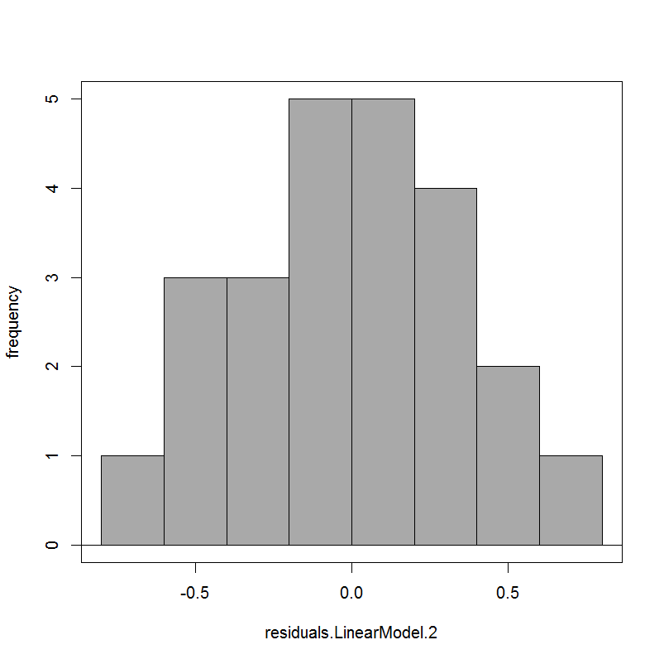
Histogram of residuals Normal distribution?

Slide 22
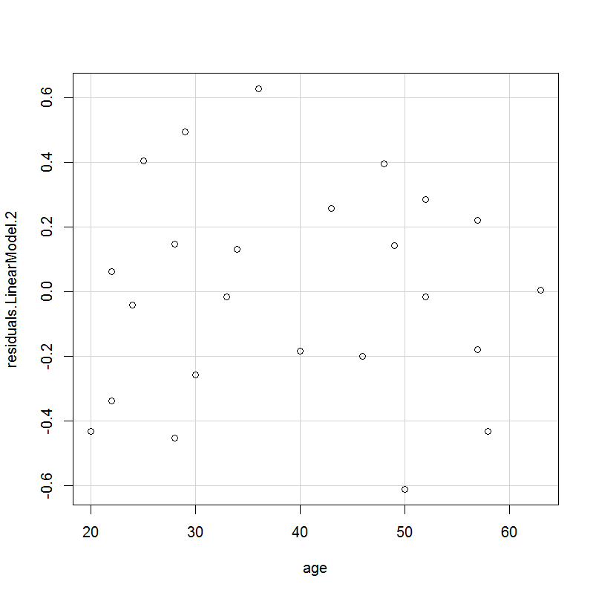
Residuals against Age linearity?

Slide 23
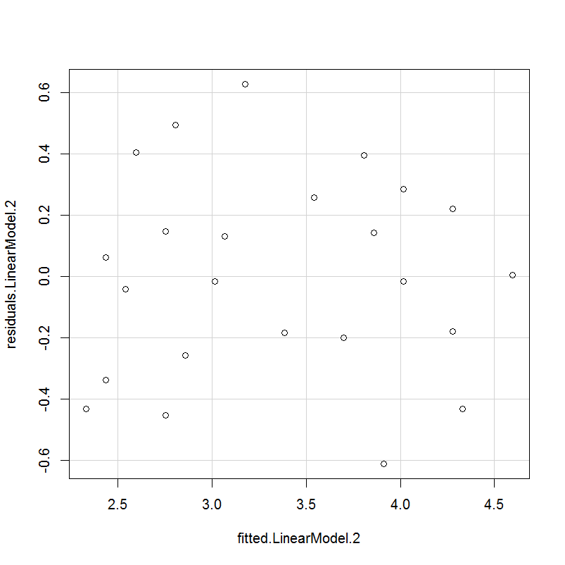
Residuals against fitted Homogeneity of variance?

Slide 24
Residuals against Age influential observations?

Slide 25
Residuals against fitted outliers?

Slide 26
Transformations
Correct for non-linearity: transformation of x variable, most frequently is logarithmic transformation
Correct for heterogeneity of variance: transformation of y variable
log transformations are useful for count data
Notes:
We can try and and correct anomalies in our model by means of transformations.
If the relationship between x and y is not linear, a transformation of the x values can possibly help to make them linear enough so that the linear regression becomes valid. The most frequently used transformation is the logarithmic one: u = log x, but other transformations also exist (e.g. reciprocal transformation u = 1/x, quadratic transformation u = x², arcsine square root transformation etc.)
Transforming the y values may correct for heterogeneous variance.

Slide 27
Notes:
<logarithmic transformation >
This is an example of a logarithmic transformation.
On the left: a graph of diameter against concentration. Taking logs of the concentration (x) gives the new graph on the right, for which a linear regression model would be appropriate.

Slide 28
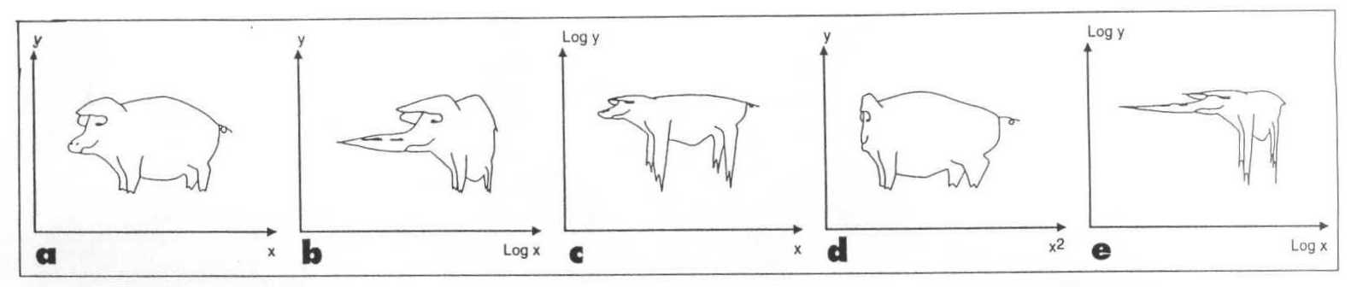
… but call a pig a pig!
from: Andersen, B. Methodological errors in medical research, Blackwell Science Publications, 1990
Notes:
<“the abused pig”>
NB: The transformation of values needs to be done with consideration and should not be abused to force significant results!

Slide 29
Multiple regression
Number of independent variables > 1
Equation: y = a + b₁x₁
To determine a/b₀ to b_{k} -> least squares method: minimize the sum of squares of the residuals
+ b₂x₂ + b₃x₃ +…+ b_{k}x_{k}
Notes:
Multiple regression is an extension of the simple linear regression, and deals with examining the influence of several independent variables at the same time on one dependent variable, e.g: the influence of weight and age at the same time on blood pressure.
The coefficient b₀ corresponds to the intercept a of the simple linear regression, while the coefficients b₁ to b_{k} correspond to the slope b of the simple linear regression. However, this is only an imperfect analogy; in multiple regression there are no such things as a straight (regression) line, an intercept and a slope. A multiple regression does not have a straightforward graphical representation.
The principle for determining the coefficients b is the same as in simple linear regression: minimise the sum of squared distances between the observed values of the dependent variable and the values fitted by the regression, or, in other words: minimise the residual variance.
As the calculation of the sums of squares is rather complex, the formulas will not be presented here. In general, one makes use of a computer to perform these calculations.

Slide 30
Multiple linear regression in R
age | cholesterol | sex | occupation | bmi | activity
20 | 1.9 | M | 4 | 16.7 | 24
22 | 2.1 | F | 4 | 19.2 | 22
28 | 2.3 | M | 2 | 22.1 | 24
22 | 2.5 | M | 1 | 20.8 | 26
24 | 2.5 | F | 4 | 20.9 | 18
30 | 2.6 | M | 2 | 18.7 | 13
28 | 2.9 | F | 3 | 22.9 | 6
25 | 3.0 | M | 2 | 22.3 | 8
33 | 3.0 | F | 4 | 24.8 | 9
34 | 3.2 | M | 2 | 22.9 | 0
40 | 3.2 | M | 3 | 21.4 | 8
29 | 3.3 | F | 4 | 23.8 | 17
50 | 3.3 | F | 1 | 23.0 | 5
46 | 3.5 | M | 3 | 22.7 | 12
36 | 3.8 | F | 4 | 24.8 | 3
43 | 3.8 | F | 4 | 25.7 | 3
58 | 3.9 | M | 3 | 25.7 | 6
49 | 4.0 | M | 2 | 28 | 8
52 | 4.0 | M | 2 | 25.3 | 2
57 | 4.1 | F | 3 | 30.3 | 5
48 | 4.2 | F | 3 | 27.1 | 13
52 | 4.3 | F | 1 | 30.1 | 15
57 | 4.5 | M | 1 | 27.9 | 4
63 | 4.6 | F | 2 | 31.7 | 11

Slide 31
Multiple linear regression in R
> LinearModel.3 <- lm(cholesterol ~ age + bmi, data=Cholesterol)
> summary(LinearModel.3)
Coefficients:
Estimate Std. Error t value Pr(>|t|)
(Intercept) -0.316695 0.405733 -0.781 0.443777
age 0.027329 0.007061 3.870 0.000885 ***
bmi 0.107546 0.025081 4.288 0.000326 ***
---
Residual standard error: 0.2497 on 21 degrees of freedom
Multiple R-squared: 0.906, Adjusted R-squared: 0.897
F-statistic: 101.2 on 2 and 21 DF, p-value: 1.657e-11

Slide 32
Multiple linear regression equation
Cholesterol (mmol/l)= -0.316695 + 0.027329 * Age (yrs) + 0.107546 * BMI

Slide 33
…what have we learnt so far:
Testing the Assumptions
Linearity
Homogeneity of variance
Normality
Independence of observations
Exceptional values = outliers
Influential observations
Transformation
Multiple linear regression

